Slide 1
weight average variance

Slide 2
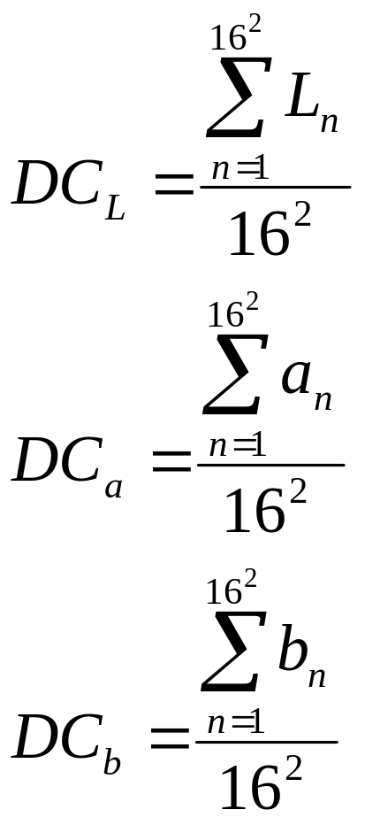
DC value calculation
16
DC_{Lab}
DC_{Lab}
DC_{Lab}
16
Macro Block
Macro Block
Macro Block
DC_{Lab}
DC_{Lab}
DC_{Lab}
Macro Block
Macro Block
Macro Block
Photo
DC_{Lab}
DC_{Lab}
DC_{Lab}
Macro Block
Macro Block
Macro Block
The width and the height of photos have to shape in 16 multiple.
e.g. 320 x 240 picture 320 / 16 = 20, 240 / 16 = 15
Macro block count = 20 * 15 = 300

Slide 3
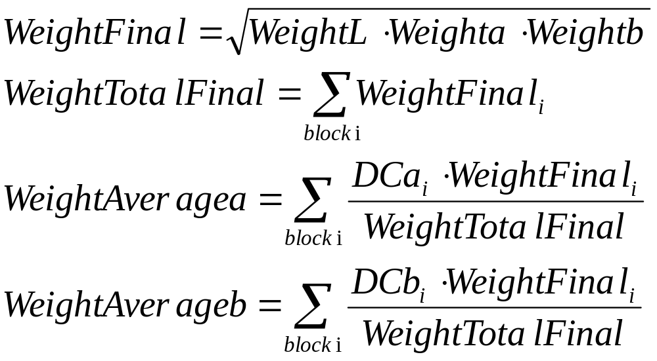
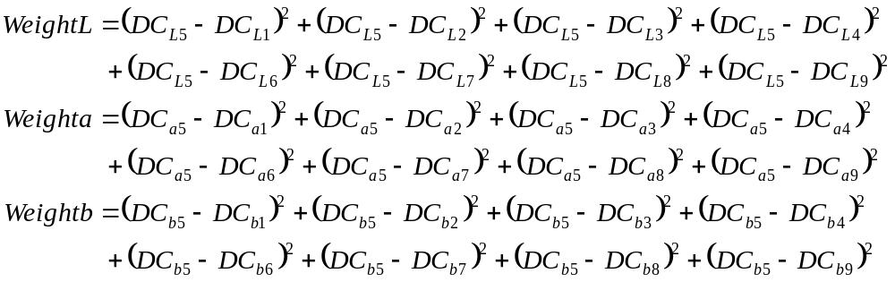
Weight value calculation
Macro block of the
nine square divisions
1 | 2 | 3
4 | 5 | 6
7 | 8 | 9

Slide 4
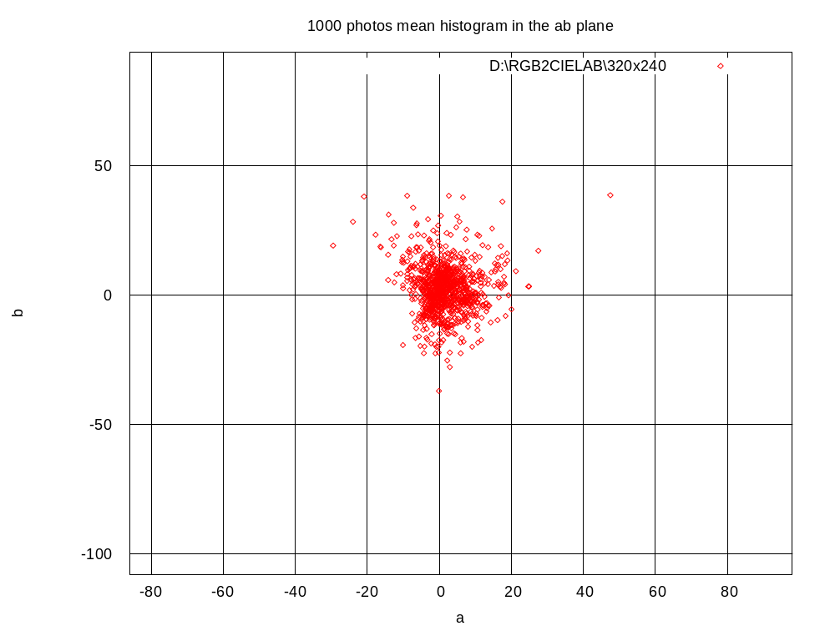
1000 outdoor photos mean histogram in the ab domain

Slide 5
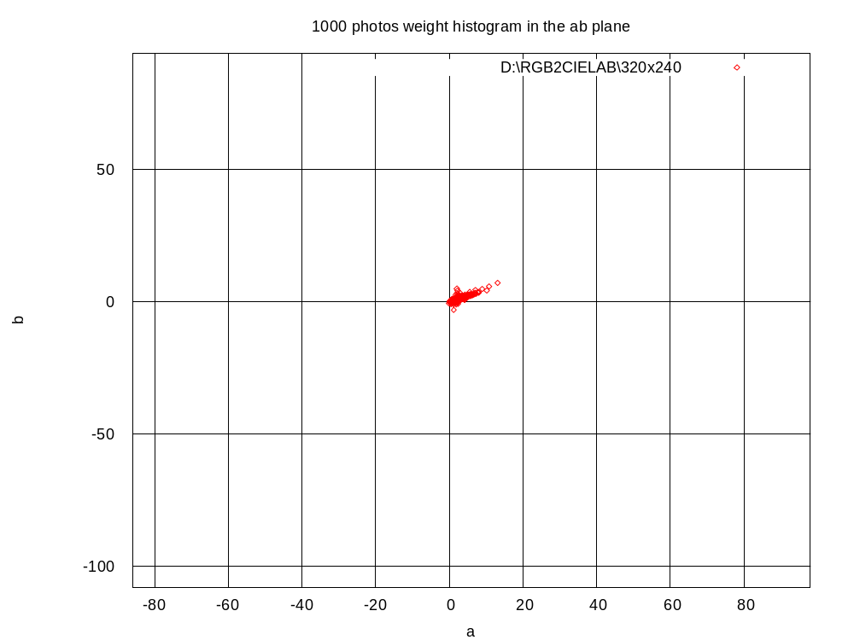
1000 outdoor photos weight histogram in the ab domain

